Slide 1
Deep Learning CS60010
Abir Das
Assistant Professor
Computer Science and Engineering Department
Indian Institute of Technology Kharagpur
http://cse.iitkgp.ac.in/~adas/

Slide 2
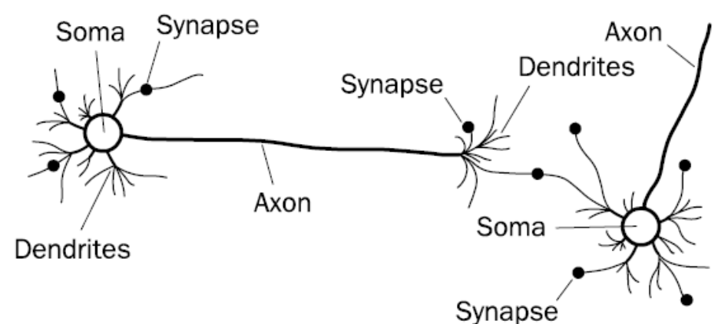
Biological Neural Network
Image courtesy: F. A. Makinde et. al., “Prediction of crude oil viscosity using feed-forward back-propagation neural network (FFBPNN)”." Petroleum & Coal 2012

Slide 3


Slide 4

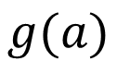
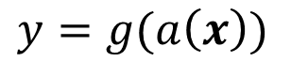
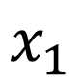
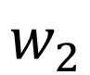
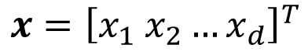
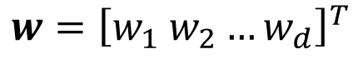
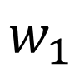
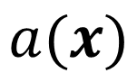
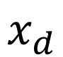
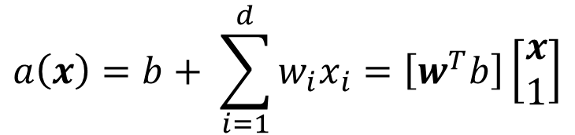
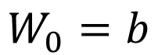
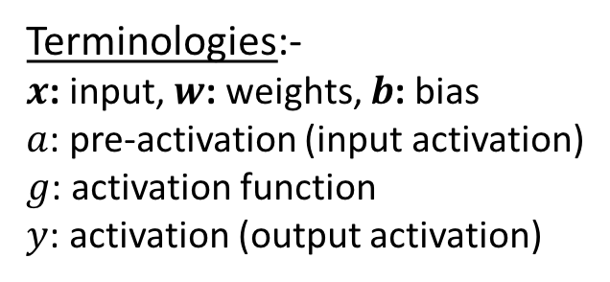
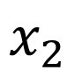

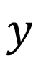
Artificial Neuron
$$w={\left[w_{1} w_{2}…w_{d}\right]}^{T}$$
and
$$x={\left[x_{1} x_{2}…x_{d}\right]}^{T}$$
$$x_{1}$$
$$a\left(x\right)=b+ \sum_{i=1}^{d}{w_{i}x_{i}}=\left[w^{T}b\right]\left[\begin{matrix}x \\ 1\end{matrix}\right]$$
$$w_{1}$$
$$w_{2}$$
$$a(x)$$
$$x_{2}$$
$$g(a)$$
$$y$$
$$y=g(a\left(x\right))$$
$$W_{0}=b$$
$$x_{d}$$
$$w_{d}$$
Terminologies:-
$x$: input, $w$: weights, $b$: bias
$a$: pre-activation (input activation)
$g$: activation function
$y$: activation (output activation)
$$1$$

Slide 5

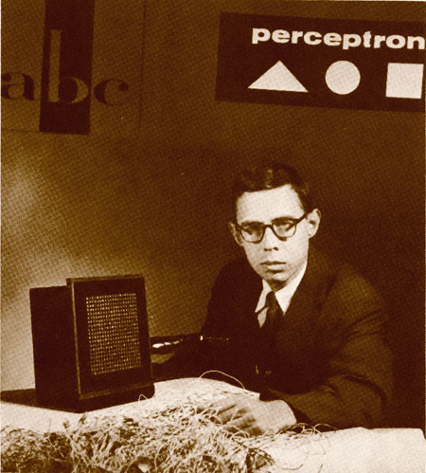
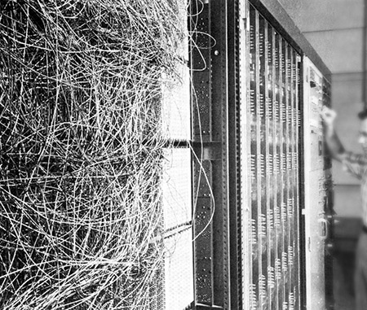
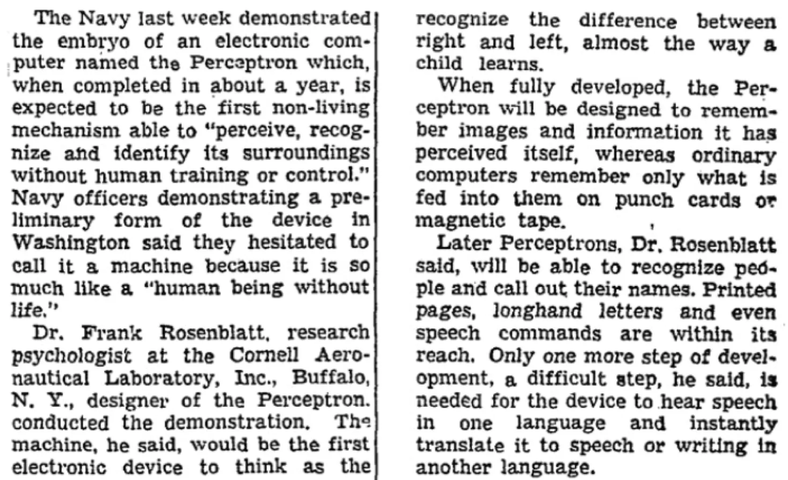
Perceptron
Image courtesy: https://blogs.umass.edu/comphon/2017/06/15/did-frank-rosenblatt-invent-deep-learning-in-1962/

Slide 6
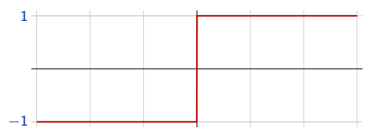
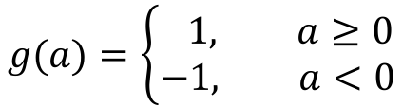
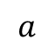
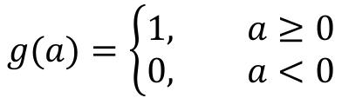
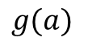
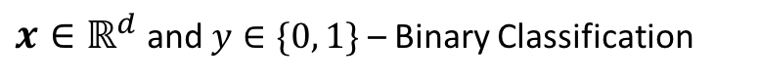

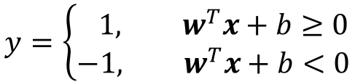
Perceptron
$x∈ℝ^{d}$ and $y∈\{0, 1\}$ – Binary Classification
$$g(a)=\left\{\begin{aligned}1, a≥0 \\ &0, a<0\end{aligned}\right.$$
(Rosenblatt, 1957)
$$x_{1}$$
$$w_{1}$$
$$w_{2}$$
To make things simpler, the response is taken as $y∈\{−1, 1\}$
$$a(x)$$
$$x_{2}$$
$$g(a)$$
$$y$$
$$g(a)=\left\{\begin{aligned} 1, a≥0 \\ &−1, a<0\end{aligned}\right.$$
$$g(a)$$
$$W_{0}=b$$
$$a$$
$$x_{d}$$
$$w_{d}$$
The perceptron classification rule, thus, translates to
$$1$$
$$y=\left\{\begin{aligned} 1, w^{T}x+b≥0 \\ &−1, w^{T}x+b<0\end{aligned}\right.$$
Remember: $w^{T}x+b=0$ represents
a hyperplane.

Slide 7
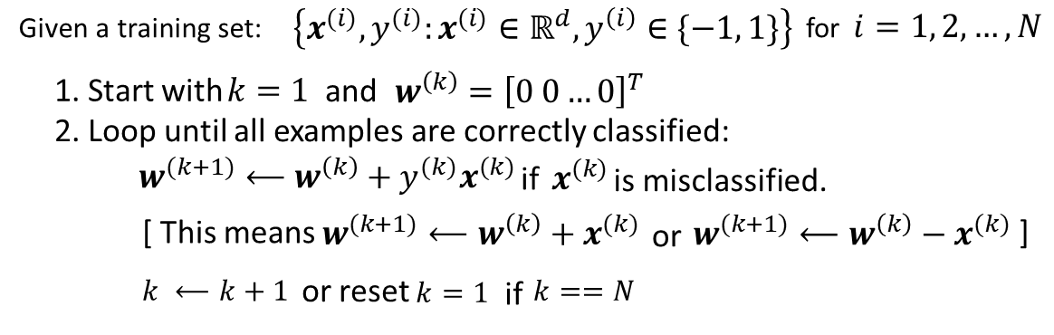
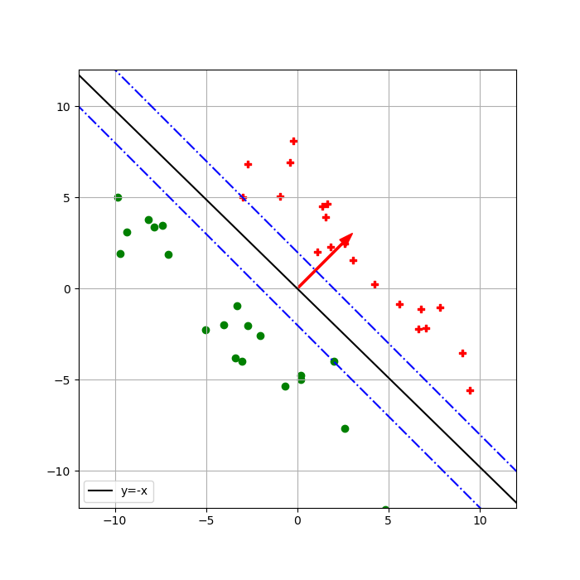
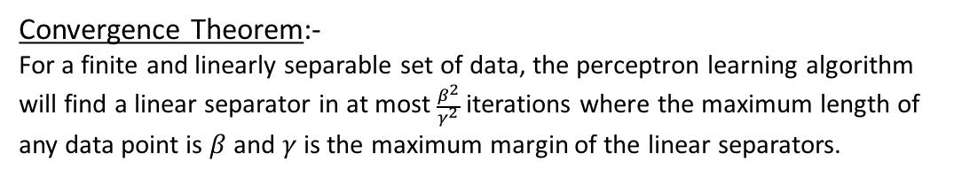
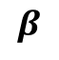
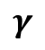
Perceptron Learning Algorithm
$$γ$$
$$β$$
Convergence Theorem:-
For a finite and linearly separable set of data, the perceptron learning algorithm will find a linear separator in at most $\frac{β^{2}}{γ^{2}}$ iterations where the maximum length of any data point is $β$ and $γ$ is the maximum margin of the linear separators.

Slide 8
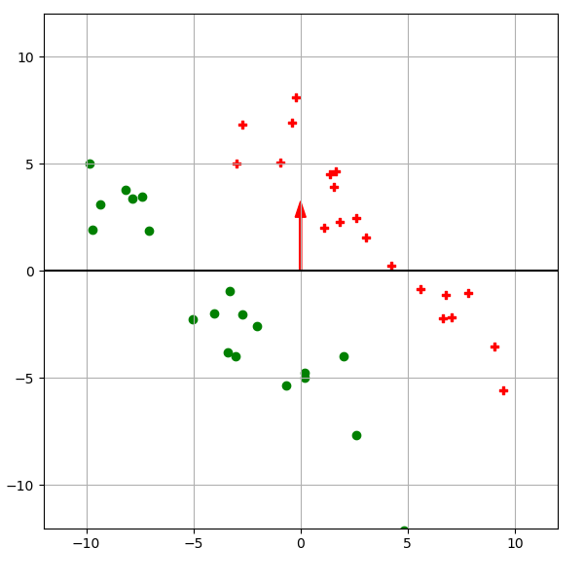
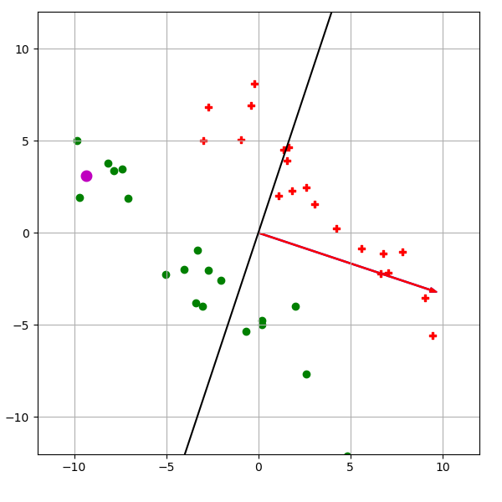
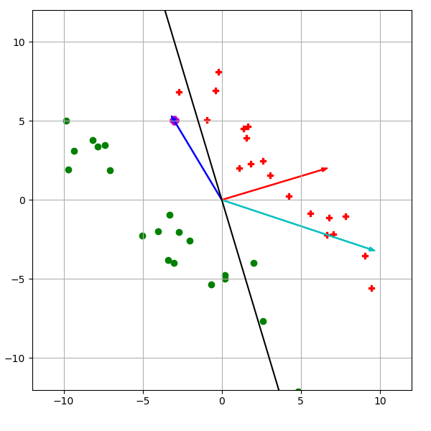
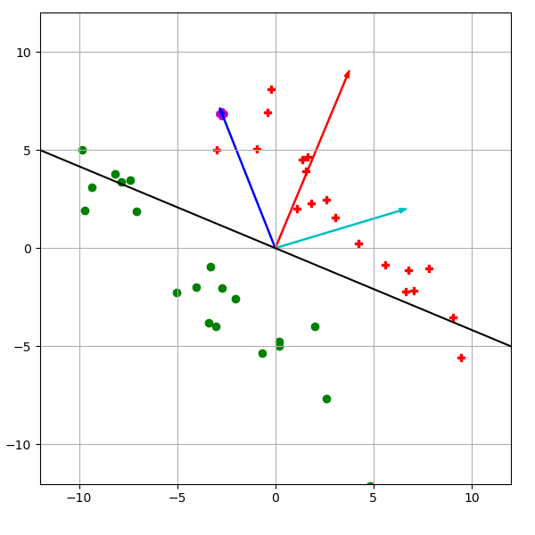
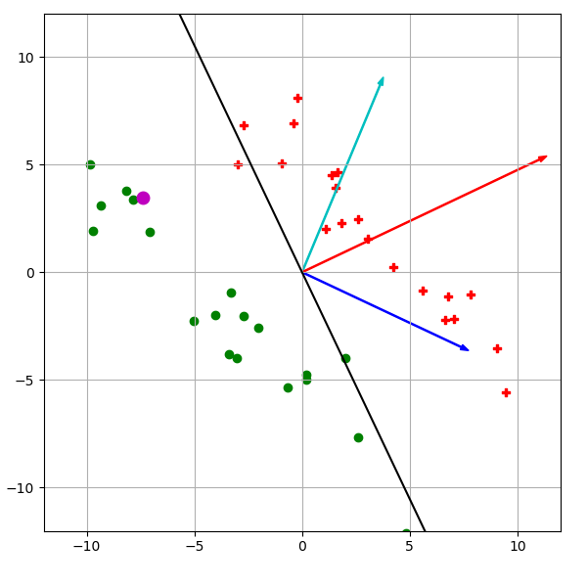
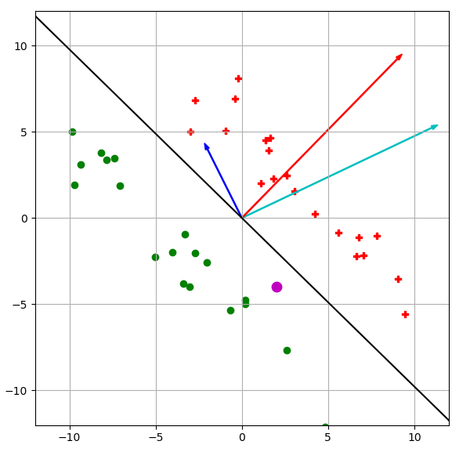

Slide 9
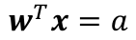
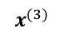
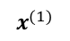
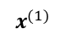
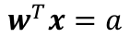

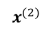
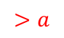
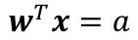
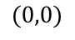
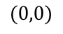
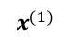
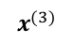

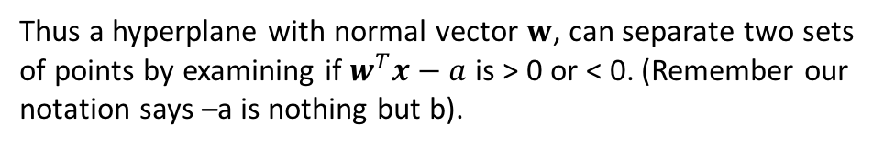
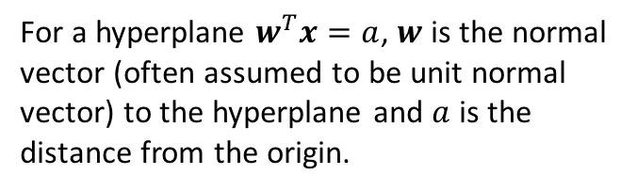





Perceptron Learning Algorithm – Convergence Proof
Some Important Brush-ups:-
$$x^{(1)}$$
$$x^{(1)}$$
$$x^{(1)}$$
$$x^{(2)}$$
$$w$$
$$x^{(2)}$$
$$w$$
$$x^{(2)}$$
$$w$$
$$x^{(3)}$$
$$x^{(3)}$$
$$x^{(3)}$$
$$>a$$
$$a$$
$$<a$$
$$(0,0)$$
$$(0,0)$$
$$(0,0)$$
$$w^{T}x=a$$
$$w^{T}x=a$$
$$w^{T}x=a$$
For a hyperplane $w^{T}x=a$, $w$ is the normal vector (often assumed to be unit normal vector) to the hyperplane and $a$ is the distance from the origin.
Thus a hyperplane with normal vector $w$, can separate two sets of points by examining if $w^{T}x−a$ is > 0 or < 0. (Remember our notation says –a is nothing but b).

Slide 10

Perceptron Learning Algorithm – Convergence Proof
Thus a simple classification rule can be $w^{T}x+b>0$ or $<0$.
For simplicity, let us assume that the hyperplane passes through origin – This does not affect the problem in our hand as it just shifts the origin. But that means $b=0$. Thus the classification rule becomes $sgn\left(w^{T}x^{\left(i\right)}\right)=y^{(i)}∀(x^{\left(i\right)},y^{(i)})$.
There may not exist such hyperplane that can separate two sets of data. If it exists then the data is known to be linearly separable.
A more formal definition is – Two sets $P$ and $N$ of $d$ dimensional points are said to be linearly separable if there exists $d+1$ real numbers ${w=(w}_{0},w_{1}, ⋯, w_{d+1})$ such that every point $x=\left(1,x_{1}, x_{2},⋯, x_{d+1}\right)∈P$, satisfies $sgn\left(w^{T}x\right)=1$ and every point $x=\left(1,x_{1}, x_{2},⋯, x_{d+1}\right)∈N$, satisfies $sgn\left(w^{T}x\right)=−1$,

Slide 11

Perceptron Learning Algorithm – Convergence Proof
Without loss of generalization we will also assume the following while proving the convergence theorem.
We normalize all the points $x^{(i)}$ so that ${max ||x}^{(i)}||=1$, i.e., maximum length of any data point is 1. Notice that this does not affect the algorithm or the solution as, $sgn\left(w^{T}x^{\left(i\right)}\right)=sgn\left(w^{T}\frac{x^{\left(i\right)}}{||x^{\left(i\right)}||}\right)$
Margin of separation: This is the minimum distance between any data point and the hyperplane $w^{T}x=0$. Such a hyperplane is defined to be the maximum margin separator. $γ=\min_{x}{|w^{T}x|}$

Slide 12



Perceptron Learning Algorithm – Convergence Proof
Let $w^{∗}$ be the normal to the maximum margin linear separator. We want our $w$ in the perceptron algorithm in each step getting closer and closer to this (sort of) ideal $w^{∗}$.
This means that the inner product between $w$ and $w^{∗}$ should increase with each update.
Remember the update rule: $w^{′}=w+x^{\left(i\right)}y^{\left(i\right)}$
So, ${\left(w^{′}\right)}^{T}w^{∗}={\left(w+x^{\left(i\right)}\right)}^{T}w^{∗}$(assuming $y^{\left(i\right)}=+1$) $=w^{T}w^{∗}+{\left(x^{\left(i\right)}\right)}^{T}w^{∗}$
Similarly for a negative training example,
$${\left(w^{′}\right)}^{T}w^{∗}={\left(w−x^{\left(i\right)}\right)}^{T}w^{∗}=w^{T}w^{∗}−{\left(x^{\left(i\right)}\right)}^{T}w^{∗}$$
${\left(x^{\left(i\right)}\right)}^{T}w^{∗}$ is negative as the example is negative and thus $−{\left(x^{\left(i\right)}\right)}^{T}w^{∗}≥γ$.
So, in both cases ${\left(w^{′}\right)}^{T}w^{∗}$ is increasing by at least $γ$. Which means length of $w^{′}$ increases with each update → Observation 1
Previous $w^{T}w^{∗}$
This is at least $γ$

Slide 13



Perceptron Learning Algorithm – Convergence Proof
length of $w^{′}$is given by ${||w}^{′}|{\left.​\right|}^{2}$. Let us see, how this changes with each update.
${||w}^{′}|{\left.​\right|}^{2}={\left(w^{′}\right)}^{T}w^{′}={\left(w+x^{\left(i\right)}y^{\left(i\right)}\right)}^{T}\left(w+x^{\left(i\right)}y^{\left(i\right)}\right)={\left|\left|w\right|\right|}^{2}+2y^{\left(i\right)}{\left(x^{\left(i\right)}\right)}^{T}w+{\left(y^{\left(i\right)}\right)}^{2}{||x}^{\left(i\right)}|{\left.​\right|}^{2}$
Let us consider the case $y^{\left(i\right)}=+1$ first.
${||w}^{′}|{\left.​\right|}^{2}={\left|\left|w\right|\right|}^{2}+2{\left(x^{\left(i\right)}\right)}^{T}w+{||x}^{\left(i\right)}|{\left.​\right|}^{2}$
So, ${||w}^{′}|{\left.​\right|}^{2}≤{\left|\left|w\right|\right|}^{2}+1$
This is negative as update occurs only on misclassification and for $y^{\left(i\right)}=+1$, misclassification means ${\left(x^{\left(i\right)}\right)}^{T}w≤0$.
This is $≤1$, as we assumed every point is rescaled to unit ball.

Slide 14

Perceptron Learning Algorithm – Convergence Proof
Let us now consider the case $y^{\left(i\right)}=−1$.
${||w}^{′}|{\left.​\right|}^{2}={\left|\left|w\right|\right|}^{2}−2{\left(x^{\left(i\right)}\right)}^{T}w+{||x}^{\left(i\right)}|{\left.​\right|}^{2}$
Using similar arguments, ${\left(x^{\left(i\right)}\right)}^{T}w≥0$, so, $−2{\left(x^{\left(i\right)}\right)}^{T}w≤0$ and also ${||x}^{\left(i\right)}|{\left.​\right|}^{2}≤1$
So, here also ${||w}^{′}|{\left.​\right|}^{2}≤{\left|\left|w\right|\right|}^{2}+1$
So, the length of the updated vector is increasing but it is increasing in a controlled way. → Observation 2

Slide 15

Perceptron Learning Algorithm – Convergence Proof
Say after $k$ iterations, $w$ is denoted as $w_{k}$.
So observation 1 implies, $w_{k}^{T}w^{∗}≥kγ$ and observation 2 implies ${\left|\left|w_{k}\right|\right|}^{2}≤k$ [remember the initial value of $w$ is 0]
Now we have to apply the Cauchy-Swartz inequality.
$\left|\left|w_{k}\right|\right|\left|\left|w^{∗}\right|\right|≥w_{k}^{T}w^{∗}$ , but $\left|\left|w^{∗}\right|\right|=1$, so,
$\left|\left|w_{k}\right|\right|≥w_{k}^{T}w^{∗}≥kγ$ [observation 1]
This implies $k^{2}γ^{2}≤{\left|\left|w_{k}\right|\right|}^{2}≤k$ [observation 2]
So, $k≤\frac{1}{γ^{2}}$

Slide 16


Slide 17








Popular Choices of Activation Functions
Linear activation function
$g\left(a\right)=a$
Unbounded
$g′\left(a\right)=1$
Sigmoid activation function
$g\left(a\right)=σ\left(a\right)=\frac{1}{1+exp⁡(−a)}$
Bounded (0, 1)
Always positive
$g′\left(a\right)=g\left(a\right)(1−g\left(a\right))$
tanh activation function
$g\left(a\right)=tanh\left(a\right)$ $=\frac{\exp\left(a\right)−exp⁡(−a)}{exp⁡(a)+exp⁡(−a)}$
Bounded (-1, 1)
Can be positive or negative
$g′\left(a\right)=1−g^{2}(a)$
ReLU activation function
$g\left(a\right)=max⁡(0,a)$
Bounded below by 0
But not upper-bounded
$g′(a)=\left\{\begin{aligned}1, a≥0 \\ &0, a<0\end{aligned}\right.$

Slide 18






















Multilayer Neural Network
$$x_{1}$$
$$w_{1}$$
$$x_{1}$$
$$w_{1}$$
$$w_{2}$$
$$a(x)$$
$$w_{2}$$
$$x_{2}$$
$$g(a)$$
$$y$$
$$x_{2}$$
$$y$$
$$g(a)$$
$$W_{0}=b$$
$$W_{0}=b$$
$$x_{d}$$
$$w_{d}$$
$$x_{d}$$
$$w_{d}$$
$$1$$
$$1$$
A bit of notation change

Slide 19











Input Layer
Hidden Layer
Multilayer Neural Network
$$x_{1}$$
$$1$$
$$x_{2}$$
$$g(a)$$
$$1$$
Output Layer
Intuition:-
Hidden Layer: Extracts better representation of the input data
Output layer: Does the classification
$$x_{d}$$
$$y$$
$$g(a)$$
o$(a)$
$$1$$
$$g(a)$$

Slide 20









Input Layer
Hidden Layer
Multilayer Neural Network
$$x_{1}$$
$$w_{1,1}^{(1)}$$
$$1$$
$$a_{1}^{\left(1\right)}(x)=b_{1}^{(1)}+ \sum_{i=1}^{d}{w_{1,i}^{(1)} x_{i}}=\left[w_{1}^{(1)}b_{1}^{(1)}\right]\left[\begin{matrix} x \\ 1 \end{matrix}\right]$$
$$w_{1,0}^{(1)}=b_{1}^{(1)}$$
$$x_{2}$$
$$w_{1,2}^{(1)}$$
$$h_{1}^{(1)}$$
$$g(a)$$
Row vector
$$\left[w_{1, 1}^{(1)},w_{1, 2}^{(1)}, ⋯,w_{1, d}^{(1)}\right]$$
Column vector
$${\left[x_{1} x_{2}…x_{d}\right]}^{T}$$
$$h_{1}^{(1)}=g\left(a_{1}^{\left(1\right)}\left(x\right)\right)$$
$$x_{d}$$
$$w_{1,d}^{(1)}$$

Slide 21















Input Layer
Hidden Layer
Multilayer Neural Network
$$x_{1}$$
$$w_{1,1}^{(1)}$$
$$1$$
$$a_{1}^{\left(1\right)}(x)=b_{1}^{(1)}+ \sum_{i=1}^{d}{w_{1,i}^{(1)} x_{i}}=\left[w_{1}^{(1)}b_{1}^{(1)}\right]\left[\begin{matrix} x \\ 1 \end{matrix}\right]$$
$$w_{1,0}^{(1)}=b_{1}^{(1)}$$
$$w_{1,2}^{(1)}$$
$$x_{2}$$
$$w_{2,1}^{(1)}$$
$$h_{1}^{(1)}$$
$$g(a)$$
$$h_{1}^{(1)}=g\left(a_{1}^{\left(1\right)}\left(x\right)\right)$$
$$w_{2,2}^{(1)}$$
$$1$$
$$a_{2}^{\left(1\right)}(x)=b_{2}^{(1)}+ \sum_{i=1}^{d}{w_{2,i}^{(1)} x_{i}}=\left[w_{2}^{(1)}b_{2}^{(1)}\right]\left[\begin{matrix} x \\ 1 \end{matrix}\right]$$
$$w_{2,0}^{(1)}=b_{2}^{(1)}$$
$$w_{2,3}^{(1)}$$
$$h_{2}^{(1)}$$
$$x_{d}$$
$$w_{1,d}^{(1)}$$
$$g(a)$$
$$h_{2}^{(1)}=g\left(a_{2}^{\left(1\right)}\left(x\right)\right)$$

Slide 22














Input Layer
Hidden Layer
Multilayer Neural Network
$$x_{1}$$
$$w_{1,1}^{(1)}$$
$$1$$
$$a_{1}^{\left(1\right)}(x)=b_{1}^{(1)}+ \sum_{i=1}^{d}{w_{1,i}^{(1)} x_{i}}=\left[w_{1}^{(1)}b_{1}^{(1)}\right]\left[\begin{matrix} x \\ 1 \end{matrix}\right]$$
$$w_{1,0}^{(1)}=b_{1}^{(1)}$$
$$w_{1,2}^{(1)}$$
$$x_{2}$$
$$w_{2,1}^{(1)}$$
$$h_{1}^{(1)}$$
$$g(a)$$
$$h_{1}^{(1)}=g\left(a_{1}^{\left(1\right)}\left(x\right)\right)$$
$$w_{2,2}^{(1)}$$
$$1$$
$$a_{2}^{\left(1\right)}(x)=b_{2}^{(1)}+ \sum_{i=1}^{d}{w_{2,i}^{(1)} x_{i}}=\left[w_{2}^{(1)}b_{2}^{(1)}\right]\left[\begin{matrix} x \\ 1 \end{matrix}\right]$$
$$w_{2,0}^{(1)}=b_{2}^{(1)}$$
$$w_{M,2}^{(1)}$$
$$w_{2,3}^{(1)}$$
$$h_{2}^{(1)}$$
$$x_{d}$$
$$w_{1,d}^{(1)}$$
$$g(a)$$
$$h_{2}^{(1)}=g\left(a_{2}^{\left(1\right)}\left(x\right)\right)$$
$$w_{M,1}^{(1)}$$
$$a_{M}^{\left(1\right)}(x)=b_{M}^{(1)}+ \sum_{i=1}^{d}{w_{M,i}^{(1)} x_{i}}=\left[w_{M}^{(1)}b_{2}^{(1)}\right]\left[\begin{matrix} x \\ 1 \end{matrix}\right]$$
$$w_{M,3}^{(1)}$$
$$1$$
$$w_{M,0}^{(1)}=b_{M}^{(1)}$$
$$h_{M}^{(1)}=g\left(a_{M}^{\left(1\right)}\left(x\right)\right)$$
$$h_{M}^{(1)}$$
$$g(a)$$

Slide 23








Input Layer
Hidden Layer
Multilayer Neural Network
$$x_{1}$$
$$1$$
$$a_{1}^{\left(1\right)}(x)=\left[w_{1}^{(1)}b_{1}^{(1)}\right]\left[\begin{matrix} x \\ 1 \end{matrix}\right]$$
$$\left[\begin{aligned}\begin{matrix}a_{1}^{\left(1\right)}(x) \\ a_{2}^{\left(1\right)}(x) \\ ⋮\end{matrix} \\ a_{M}^{\left(1\right)}(x)\end{aligned}\right]= \left[\begin{matrix}w_{1}^{(1)} & b_{1}^{(1)} \\ \begin{aligned}w_{2}^{(1)} \\ ⋮\end{aligned} & \begin{aligned}b_{2}^{(1)} \\ ⋮\end{aligned} \\ w_{M}^{(1)} & b_{M}^{(1)}\end{matrix}\right]\left[\begin{matrix}x \\ 1\end{matrix}\right]$$
$$a_{2}^{\left(1\right)}(x)=\left[w_{2}^{(1)}b_{2}^{(1)}\right]\left[\begin{matrix} x \\ 1 \end{matrix}\right]$$
$$x_{2}$$
$$h_{1}^{(1)}$$
$$g(a)$$
$$⋮$$
$$a_{M}^{\left(1\right)}(x)=\left[w_{M}^{(1)}b_{2}^{(1)}\right]\left[\begin{matrix} x \\ 1 \end{matrix}\right]$$
$$1$$
$$a^{\left(1\right)}\left(x\right)=\left[W^{(1)}b^{(1)}\right]\left[\begin{matrix} x \\ 1 \end{matrix}\right]$$
$$x_{d}$$
$$h_{2}^{(1)}$$
$$g(a)$$
Matrix
Column vector
Column vector
Column vector
$$1$$
$$\left[\begin{aligned}\begin{matrix}h_{1}^{(1)} \\ h_{2}^{(1)} \\ ⋮\end{matrix} \\ h_{M}^{(1)} \end{aligned}\right]=\left[\begin{aligned}\begin{matrix}g\left(a_{1}^{\left(1\right)}\right) \\ g\left(a_{2}^{\left(1\right)}\right) \\ ⋮\end{matrix} \\ g\left(a_{M}^{\left(1\right)}\right)\end{aligned}\right]$$
Hidden Layer Activation
$$h^{\left(1\right)}=g\left(a^{(1)}\right)$$
$$h_{M}^{(1)}$$
$$g(a)$$

Slide 24








Input Layer
Hidden Layer
Multilayer Neural Network
$$x_{1}$$
$$1$$
Output Layer Pre-activation
$$a_{1}^{\left(2\right)}(h^{(1)})=\left[w_{1}^{(2)}b_{1}^{(2)}\right]\left[\begin{matrix}h^{(1)} \\ 1 \end{matrix}\right]$$
$$x_{2}$$
$$h_{1}^{(1)}$$
$$g(a)$$
$$w_{1,1}^{(2)}$$
Output Layer
Output Layer Activation
$$1$$
$$y=o\left(a_{1}^{\left(2\right)}(h^{(1)})\right)$$
$$h_{2}^{(1)}$$
$$x_{d}$$
$$y$$
$$g(a)$$
o$(a)$
o can have many options
sigmoid
tanh
Relu etc.
$$w_{1,2}^{(2)}$$
$$1$$
$$w_{1,M}^{(2)}$$
One special is softmax function
$$g(a)$$
$$h_{M}^{(1)}$$

Slide 25









Input Layer
Hidden Layer
Multilayer Neural Network
Output Layer
$$x_{1}$$
$$1$$
$$a_{1}^{(2)}$$
$${y_{1}=o}_{1}\left(a^{(2)}\right)=\frac{exp⁡(a_{1}^{(2)})}{\sum_{c}{exp⁡(a_{c}^{(2)})}}$$
$$x_{2}$$
$$g(a)$$
o$(a)$
$$1$$
Softmax function:
Exponentiate each component of output activation vector and elementwise divide by the sum of the exponentials.
$$a_{2}^{(2)}$$
$${y_{2}=o}_{2}\left(a^{(2)}\right)=\frac{exp⁡(a_{2}^{(2)})}{\sum_{c}{exp⁡(a_{c}^{(2)})}}$$
$$x_{d}$$
$$g(a)$$
o$(a)$
$$1$$
$$a_{C}^{(2)}$$
$${y_{C}=o}_{C}\left(a^{(2)}\right)=\frac{exp⁡(a_{C}^{(2)})}{\sum_{c}{exp⁡(a_{c}^{(2)})}}$$
$$g(a)$$
o$(a)$

Slide 26











Training a Neural Network – Loss Function
$$x_{1}$$
$$1$$
$$x_{2}$$
Probability that $x$ belongs to class 1
So we can aim to maximize the probability corresponding to the correct class for any example $x$
$$y_{1}$$
$$g(a)$$
o$(a)$
$$1$$
Probability that $x$ belongs to class 2
$$\max{y_{c}}$$
$$x_{d}$$
$$y_{2}$$
$$g(a)$$
o$(a)$
$$≡max (log{y_{c}})$$
$$≡min (−log{y_{c}})$$
$$1$$
Can be equivalently expressed as $−\sum_{i}{𝕀\left(i=c\right)log⁡(y_{i})}$ known as cross-entropy loss
Probability that $x$ belongs to class C
$$y_{C}$$
$$g(a)$$
o$(a)$

Slide 27

















Forward Pass in a Nutshell
$θ$ is the collection of all learnable parameters i.e., all $W$ and $b$
$$x$$
$${(h}^{(0)})$$
$$W^{(1)},b^{(1)}$$
$$g(.)$$
$$W^{(2)},b^{(2)}$$
$$g(.)$$
$$W^{(L)},b^{(L)}$$
o$(.)$
$$y=f(x, θ)$$
$$a^{(1)}$$
$$h^{(1)}$$
$$a^{(2)}$$
$$h^{(2)}$$
$$a^{(L)}$$
Hidden layer pre-activation:
For $l=1,…,L; a^{\left(l\right)}=W^{\left(l\right)}h^{\left(l−1\right)}+b^{(l)}$
Hidden layer activation:
For $l=1,…,L−1; h^{\left(l\right)}={g(a}^{\left(l\right)})$
Output layer activation:
For $l=L; h^{\left(L\right)}={o(a}^{\left(L\right)})=f(x, θ)$

Slide 28















Backpropagation
$$h^{(l−1)}$$
$$W^{(l)},b^{(l)}$$
$$g(.)$$
$$W^{(l+1)},b^{(l+1)}$$
$$g(.)$$
$$W^{(L)},b^{(L)}$$
o$(.)$
$$y=f(x, θ)$$
$$a^{(l)}$$
$$h^{(l)}$$
$$a^{(l+1)}$$
$$h^{(l+1)}$$
$$a^{(L)}$$
$$J\left(f\left(x, θ\right),c \right)$$
True class of the example
For gradient descent we need to compute $\frac{∂J}{∂W_{i,j}^{(l)}}$ and $\frac{∂J}{∂b_{i}^{(l)}} ∀i,j,l$
Backpropagation consists of intelligent use of the chain rule of differentiation for computation of these gradients

Slide 29




Backpropagation
$$h^{(l−1)}$$
$$W^{(l)},b^{(l)}$$
$$g(.)$$
$$W^{(l+1)},b^{(l+1)}$$
$$g(.)$$
$$W^{(L)},b^{(L)}$$
o$(.)$
$$y=f(x, θ)$$
$$a^{(l)}$$
$$h^{(l)}$$
$$a^{(l+1)}$$
$$h^{(l+1)}$$
$$a^{(L)}$$
$$J\left(f\left(x, θ\right),c \right)$$
$W_{i,j}^{(l)}$ influences $J$ through $a_{i}^{(l)}$. That means $J$ is a function of $a_{i}^{(l)}$ and $a_{i}^{(l)}$, in turn, is a function of$W_{i,j}^{(l)}$
$$\frac{∂J}{∂W_{i,j}^{(l)}}=\frac{∂J}{∂a_{i}^{(l)}}\frac{∂a_{i}^{(l)}}{∂W_{i,j}^{(l)}}$$
$$a_{i}^{\left(l\right)}=\sum_{j}{W_{i,j}^{(l)} h_{j}^{(l−1)}}+b_{i}^{(l)}=W_{i,1}^{(l)} h_{1}^{(l−1)}+W_{i,2}^{(l)} h_{2}^{(l−1)}+…+W_{i,j}^{\left(l\right)} h_{j}^{\left(l−1\right)}+…+b_{i}^{(l)}$$
$$⇒\frac{∂J}{∂W_{i,j}^{(l)}}=\frac{∂J}{∂a_{i}^{(l)}}\frac{∂a_{i}^{(l)}}{∂W_{i,j}^{(l)}}=\frac{∂J}{∂a_{i}^{(l)}}h_{j}^{\left(l−1\right)}$$
… (1)
We know $h_{j}^{\left(l−1\right)}$ from forward pass, so we need $\frac{∂J}{∂a_{i}^{(l)}}$
And similarly $\frac{∂J}{∂b_{i}^{(l)}}=\frac{∂J}{∂a_{i}^{(l)}}\frac{∂a_{i}^{(l)}}{∂b_{i}^{(l)}}=\frac{∂J}{∂a_{i}^{(l)}}$
… (2)

Slide 30

Backpropagation
$$h^{(l−1)}$$
$$W^{(l)},b^{(l)}$$
$$g(.)$$
$$W^{(l+1)},b^{(l+1)}$$
$$g(.)$$
$$W^{(L)},b^{(L)}$$
o$(.)$
$$y=f(x, θ)$$
$$a^{(l)}$$
$$h^{(l)}$$
$$a^{(l+1)}$$
$$h^{(l+1)}$$
$$a^{(L)}$$
$$J\left(f\left(x, θ\right),c \right)$$
$a_{i}^{(l)}$ influences $J$ through $h_{i}^{(l)}$. That means $J$ is a function of $h_{i}^{(l)}$ and $h_{i}^{(l)}$, in turn, is a function of$a_{i}^{(l)}$
$$\frac{∂J}{∂a_{i}^{(l)}}=\frac{∂J}{∂h_{i}^{(l)}}\frac{∂h_{i}^{(l)}}{∂a_{i}^{(l)}}=\frac{∂J}{∂h_{i}^{(l)}}g′\left(a_{i}^{(l)}\right)$$
… (3)
We know $g′\left(a_{i}^{(l)}\right)$ from forward pass, so we need $\frac{∂J}{∂h_{i}^{(l)}}$

Slide 31




Backpropagation
$$h^{(l−1)}$$
$$W^{(l)},b^{(l)}$$
$$g(.)$$
$$W^{(l+1)},b^{(l+1)}$$
$$g(.)$$
$$W^{(L)},b^{(L)}$$
o$(.)$
$$y=f(x, θ)$$
$$a^{(l)}$$
$$h^{(l)}$$
$$a^{(l+1)}$$
$$h^{(l+1)}$$
$$a^{(L)}$$
$$J\left(f\left(x, θ\right),c \right)$$
$h_{i}^{(l)}$ influences $J$ through $a_{1:M_{l+1}}^{(l+1)}$ . That means $J$ is a function of${ a}_{1:M_{l+1}}^{(l+1)}$and each of $a_{1:M_{l+1}}^{(l+1)}$, in turn, is a function of$h_{i}^{(l)}$
Number of neurons in hidden layer $(l+1)$
$$\frac{∂J}{∂h_{i}^{(l)}}=\sum_{m=1}^{M_{l+1}}{\frac{∂J}{∂a_{m}^{(l+1)}}}\frac{∂a_{m}^{(l+1)}}{∂h_{i}^{(l)}}$$
Remember I$f, u=f\left(x,y\right), where x=φ\left(t\right), y=ψ\left(t\right), then \frac{∂u}{∂t}=\frac{∂u}{∂x}\frac{∂x}{∂t}+\frac{∂u}{∂y}\frac{∂y}{∂t}$
$$a_{m}^{\left(l+1\right)}=\sum_{j}{W_{m,j}^{(l+1)} h_{j}^{(l)}}+b_{m}^{(l+1)}=W_{m,1}^{(l+1)} h_{1}^{(l)}+W_{m,2}^{(l+1)} h_{2}^{(l)}+…+W_{m,i}^{\left(l+1\right)} h_{i}^{\left(l\right)}+…+b_{m}^{(l+1)}$$
$$⇒\frac{∂J}{∂h_{i}^{(l)}}=\sum_{m=1}^{M_{l+1}}{\frac{∂J}{∂a_{m}^{(l+1)}}}W_{m,i}^{\left(l+1\right)}$$
… (4)

Slide 32














Backpropagation
$$\left[W_{m,i}^{(l)} \right]$$
$$b_{i}^{(l)}$$
$$\left[W_{i,j}^{(l)} \right]$$
$$h_{j}^{\left(l−1\right)}$$
$$×$$
$$+$$
$$a_{i}^{(l)}$$
$$g(.)$$
$$h_{j}^{\left(l\right)}$$
$$\frac{∂J}{∂a_{i}^{(l)}}=\frac{∂J}{∂h_{i}^{(l)}}g′\left(a_{i}^{(l)}\right)$$
… (3)
$$g′(.)$$
$$\frac{∂J}{∂a_{i}^{(l)}}$$
$$×$$
$$\frac{∂J}{∂h_{i}^{(l)}}$$

Slide 33


Backpropagation
$$\left[W_{m,i}^{(l)} \right]$$
$$\frac{∂J}{∂b_{i}^{(l)}}$$
$$b_{i}^{(l)}$$
$$\left[W_{i,j}^{(l)} \right]$$
$$h_{j}^{\left(l−1\right)}$$
$$×$$
$$+$$
$$a_{i}^{(l)}$$
$$g(.)$$
$$h_{j}^{\left(l\right)}$$
$$\frac{∂J}{∂a_{i}^{(l)}}=\frac{∂J}{∂h_{i}^{(l)}}g′\left(a_{i}^{(l)}\right)$$
… (3)
$$\frac{∂J}{∂b_{i}^{(l)}}=\frac{∂J}{∂a_{i}^{(l)}}$$
… (2)
$$g′(.)$$
$$\frac{∂J}{∂a_{i}^{(l)}}$$
$$×$$
$$\frac{∂J}{∂h_{i}^{(l)}}$$

Slide 34



Backpropagation
$$\left[W_{m,i}^{(l)} \right]$$
$$\frac{∂J}{∂W_{i,j}^{(l)}}$$
$$\frac{∂J}{∂b_{i}^{(l)}}$$
$$b_{i}^{(l)}$$
$$\left[W_{i,j}^{(l)} \right]$$
$$×$$
$$h_{j}^{\left(l−1\right)}$$
$$×$$
$$+$$
$$a_{i}^{(l)}$$
$$g(.)$$
$$h_{j}^{\left(l\right)}$$
$$\frac{∂J}{∂a_{i}^{(l)}}=\frac{∂J}{∂h_{i}^{(l)}}g′\left(a_{i}^{(l)}\right)$$
… (3)
$$\frac{∂J}{∂b_{i}^{(l)}}=\frac{∂J}{∂a_{i}^{(l)}}$$
… (2)
$$g′(.)$$
$$\frac{∂J}{∂W_{i,j}^{(l)}}=\frac{∂J}{∂a_{i}^{(l)}}h_{j}^{\left(l−1\right)}$$
… (1)
$$\frac{∂J}{∂a_{i}^{(l)}}$$
$$×$$
$$\frac{∂J}{∂h_{i}^{(l)}}$$

Slide 35





Backpropagation
$$\left[W_{m,i}^{(l)} \right]$$
$$\frac{∂J}{∂W_{i,j}^{(l)}}$$
$$\frac{∂J}{∂b_{i}^{(l)}}$$
$$b_{i}^{(l)}$$
$$\left[W_{i,j}^{(l)} \right]$$
$$×$$
$$h_{j}^{\left(l−1\right)}$$
$$×$$
$$+$$
$$a_{i}^{(l)}$$
$$g(.)$$
$$h_{j}^{\left(l\right)}$$
$$\frac{∂J}{∂a_{i}^{(l)}}=\frac{∂J}{∂h_{i}^{(l)}}g′\left(a_{i}^{(l)}\right)$$
… (3)
$$∀i=1:M_{L}$$
$$\frac{∂J}{∂b_{i}^{(l)}}=\frac{∂J}{∂a_{i}^{(l)}}$$
… (2)
$$g′(.)$$
$$\frac{∂J}{∂W_{i,j}^{(l)}}=\frac{∂J}{∂a_{i}^{(l)}}h_{j}^{\left(l−1\right)}$$
… (1)
$$\frac{∂J}{∂h_{i}^{(l−1)}}$$
$$×$$
$$\frac{∂J}{∂a_{i}^{(l)}}$$
$$\frac{∂J}{∂h_{i}^{(l)}}$$
$$\frac{∂J}{∂h_{i}^{(l−1)}}=\sum_{m=1}^{M_{l}}{\frac{∂J}{∂a_{m}^{(l)}}}W_{m,i}^{\left(l\right)}$$
and
$$∀i=1:M_{L}$$
$$×$$
… (4)
$$+$$

Slide 36

Training Multilayer Neural Network for non-linearly Separable Data
Training Data

Slide 37








Learned Decision Boundary with Single Hidden Layer
# of hidden neurons = 2
# of hidden neurons = 4
# of hidden neurons = 8
# of hidden neurons = 16
# of hidden neurons = 32
# of hidden neurons = 64
# of hidden neurons = 128
# of hidden neurons = 256

Slide 38





Learned Decision Boundary with Two Hidden Layers
# of neurons in each hidden layer = 2
# of neurons in each hidden layer = 4
# of neurons in each hidden layer = 8
# of neurons in each hidden layer = 16
# of neurons in each hidden layer = 32

